Slide 1
MULTIPLE BREAK REBAR
Advisor : Prof. K.C.Chang
Presenters : You-Ran Nai

Slide 2
Incremental Dynamic Analysis with Multi-Modes for Seismic Performance Evaluation of RC Bridges
Prakit Chomchuen, Virote Boonyapinyo
Engineering Structures
February 2017
Notes:
標題
作者
期刊名稱
年份

Slide 3
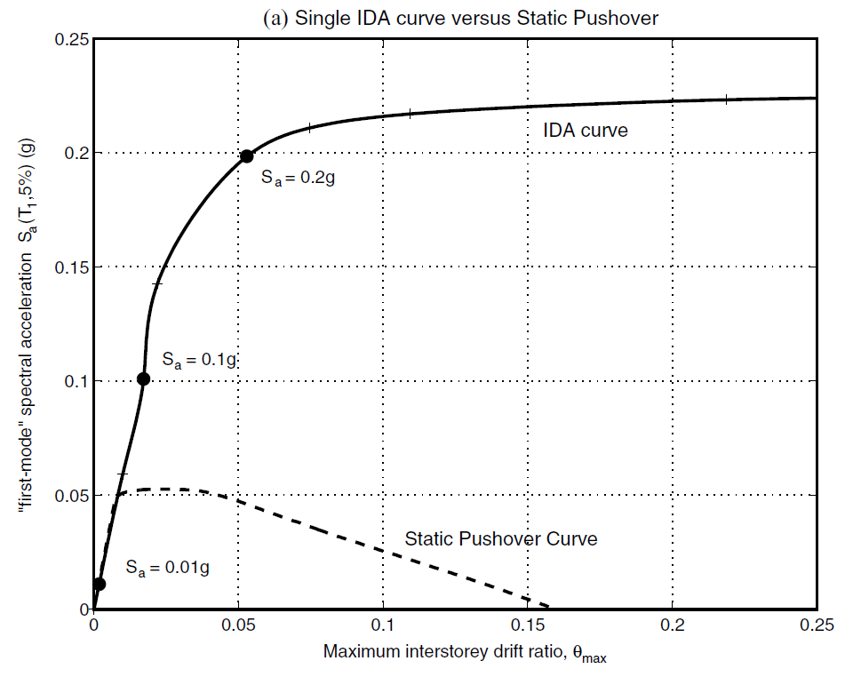
IDA Curve
MDOF
Nonlinear Time History Analyses
Intensity Measure
Reduce the computational price and time
Damage Measure
Nonlinear Static Analysis
MDOF
ESDOF
Higher Mode
INCREMENTAL DYNAMIC ANALYSIS
Notes:
傳統的
耐震評估以 IDA Curve 作為手段之一

Slide 4
Require Experienced
Modal Pushover Analysis (MPA)
Energy-Based Pushover Analysis (EPA)
Adaptive Pushover Analysis (APA)
Notes:
已經提出了幾種方法來解釋NSA中的較高模式效應
MPA要求在各種考慮的模態負載模式下對NSA進行多次分析，而EPA和APA需要經驗豐富的工程師

Slide 5
Principal Objectives
Three Different Heights
Seismic Performance
Higher Mode
A lateral load pattern that includes higher mode effect for single-run displacement-based NSA to evaluate the lateral behavior of ESDOF.
Applicability of IDA of ESDOF with proposed load pattern in evaluating seismic performance of single column RC with three different column heights.
Evaluate the seismic performance of the typically single-column reinforced concrete bridge used in Thailand.

Slide 6
Outline
1
2
3
4
5
Case study of single-column RC bridge structures
Seismic performance evaluation by incremental dynamic analysis
Nonlinear static analysis of the studied bridges with various load patterns
Incremental dynamic analysis of studied bridges by ESDOF with various load patterns
Performance of the bridges under considered earthquake

Slide 7
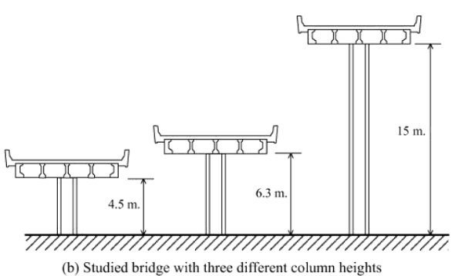
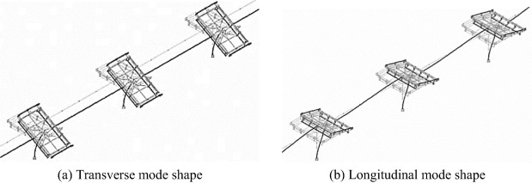
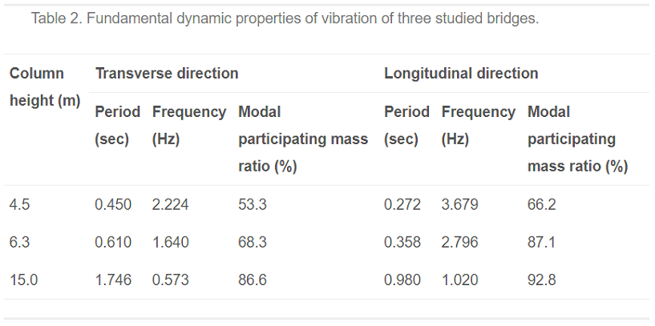
Case study of single-column RC bridge structures
Notes:
這些結果表明，具有高柱的橋樑的振動主要由基本模式決定。
當橋柱高度減小時，更高模式可能更有影響。

Slide 8
Outline
1
2
3
4
5
Case study of single-column RC bridge structures
Seismic performance evaluation by incremental dynamic analysis
Nonlinear static analysis of the studied bridges with various load patterns
Incremental dynamic analysis of studied bridges by ESDOF with various load patterns
Performance of the bridges under considered earthquake

Slide 9
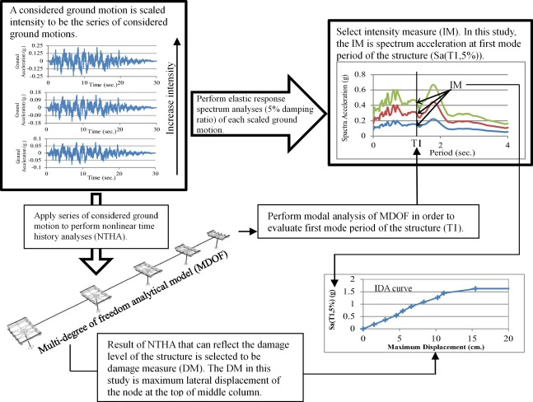
IDA of multi-degree of freedom system

Slide 10
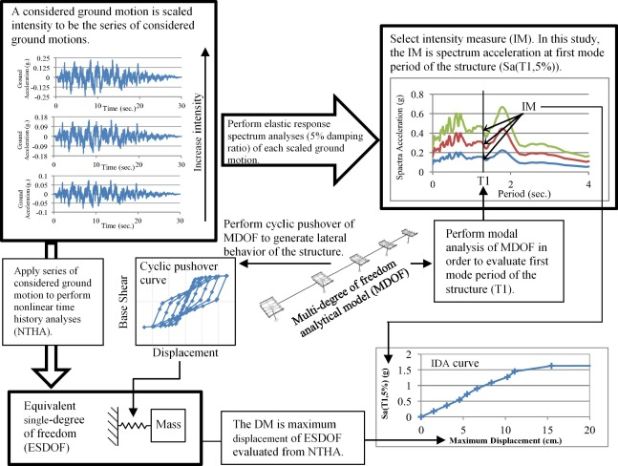
IDA of ESDOF based on nonlinear static analysis

Slide 11
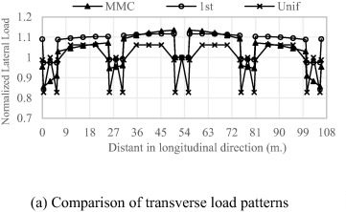

Lateral load pattern for single-run nonlinear static analysis
FEMA 356
First mode load pattern (1st)
Uniform acceleration load pattern (Unif)
Multi-Modes Combination load pattern (MMC)
Notes:
Kunnath
Fj是j自由度的力
Γn是n模式的模態參與質量比
φnj是n模式的j自由度下的模式形狀值

Slide 12
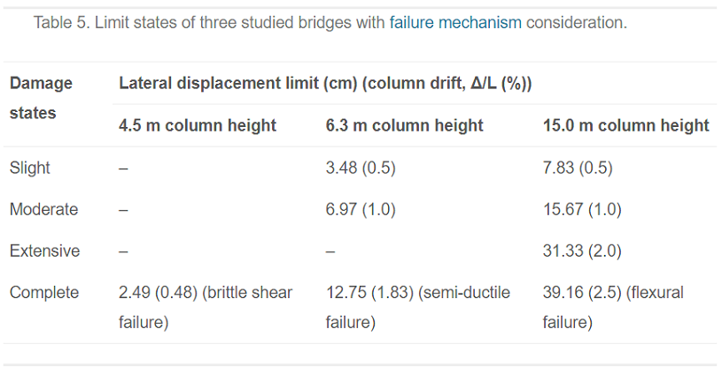
Limit states of the studied bridges

Slide 13
Outline
1
2
3
4
5
Case study of single-column RC bridge structures
Seismic performance evaluation by incremental dynamic analysis
Nonlinear static analysis of the studied bridges with various load patterns
Incremental dynamic analysis of studied bridges by ESDOF with various load patterns
Performance of the bridges under considered earthquake

Slide 14
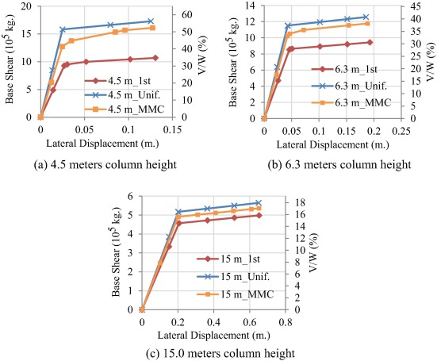
Nonlinear static analysis of the studied bridges with various load patterns

Slide 15
Outline
1
2
3
4
5
Case study of single-column RC bridge structures
Seismic performance evaluation by incremental dynamic analysis
Nonlinear static analysis of the studied bridges with various load patterns
Incremental dynamic analysis of studied bridges by ESDOF with various load patterns
Performance of the bridges under considered earthquake

Slide 16
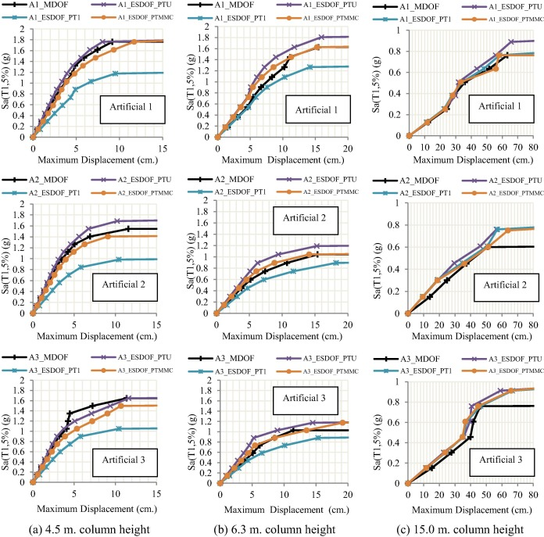
Effect of lateral load pattern on the IDA curves

Slide 17
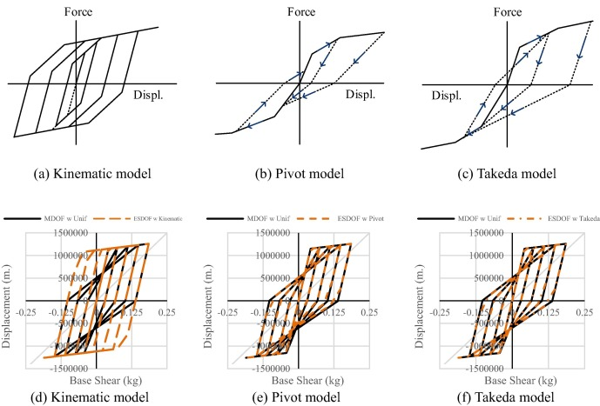
Hysteresis modeling

Slide 18
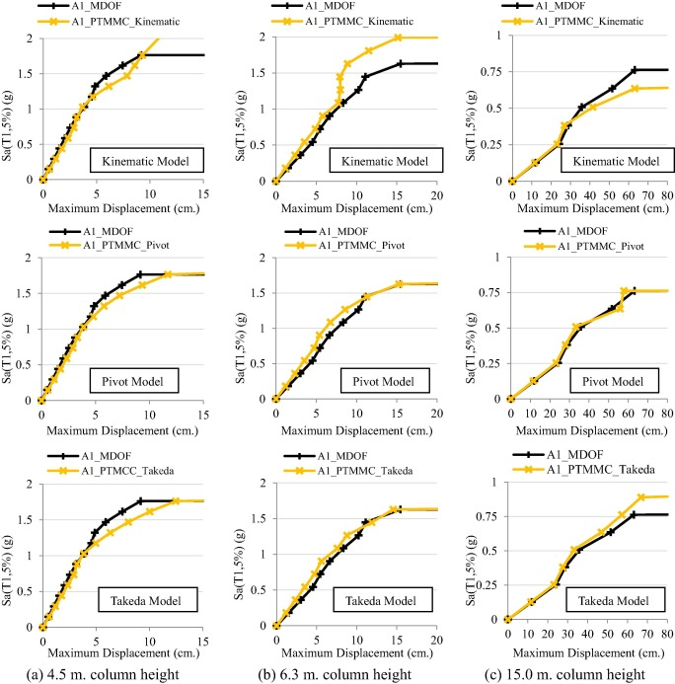
Comparison of IDA curves evaluated by IDA of ESDOF with three different hysteresis models

Slide 19
Outline
1
2
3
4
5
Case study of single-column RC bridge structures
Seismic performance evaluation by incremental dynamic analysis
Nonlinear static analysis of the studied bridges with various load patterns
Incremental dynamic analysis of studied bridges by ESDOF with various load patterns
Performance of the bridges under considered earthquake

Slide 20
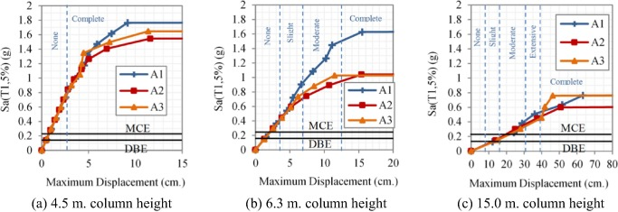
Evaluation by NTHA of MDOF model of bridges

Slide 21
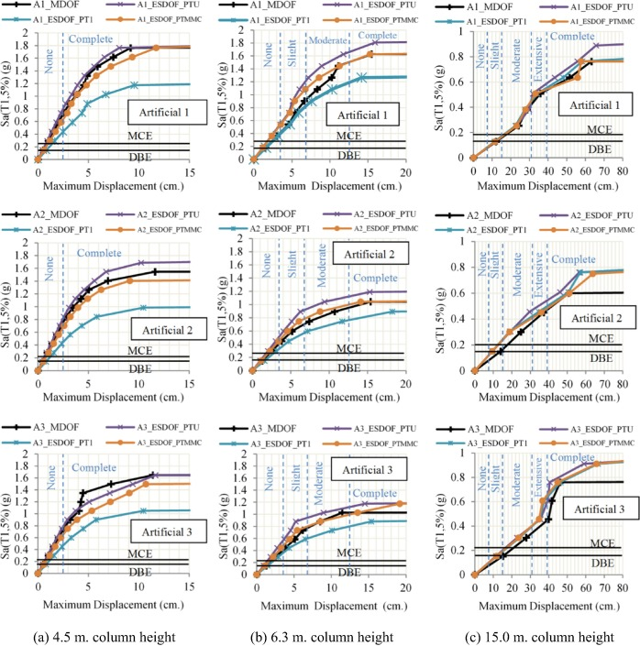
Efficiency of ESDOF with various load patterns in evaluating the seismic performance of the bridges

Slide 22
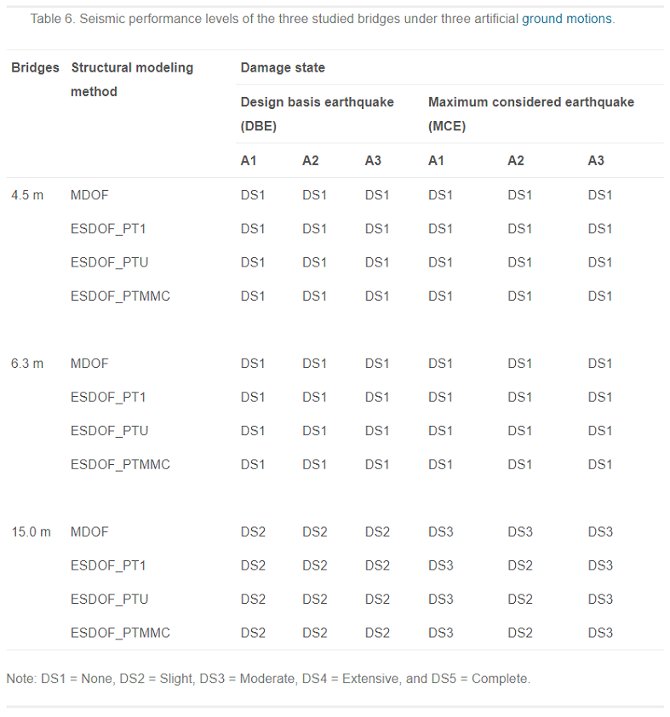
Efficiency of ESDOF with various load patterns in evaluating the seismic performance of the bridges

Slide 23
Conclusions

Slide 24
學習心得
細節交代得很清楚
前提條件講得很清楚
這是目前讀過講得非常清楚的一篇 paper

